Slide 1
Methods of exploring NEON mosquito data in R
Charlotte Roiger
Undergraduate Research Intern
Fundamental Sentinel Unit
07/10/2017

Slide 2
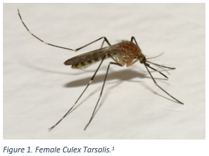
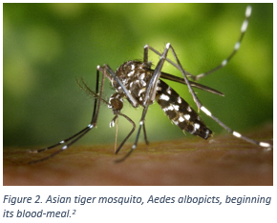
Why Study Mosquitoes?
Mosquitoes are key members of both aquatic and terrestrial food chains
Mosquitoes are known vectors for human diseases (Rochlin et al. 2013)
A useful taxon for studying the impacts of climate change (Hoekman et al. 2016)
Notes:
Vectors for diseases: For example the species Culex tarsalis and Aedes Albopictus, pictured here, are known to be carriers of WNV. So as the climate and land uses change over time, it is important to study how mosquitoes might react to these changes to aide public health endeavors. In a recent study by Rochlin et al. predicts that as average winter-time temperatures increase and as cities become more densely populated, the range of Ae. albo will expland, putting a larger number of people at risk for contracting WNV, thus highlighting the importance of studying mosquitoes in relation to human diseases.
As outlined in the NEON mosquito sampling and design manual by Hoekman et al. mosquito are useful as a sentinel taxon because of their developmental sensitivity to changes in temperature and precipitation, as well as their short generation times.
In order for ecologists to explore these important issues relating to mosquitoes they need data. And that’s where NEON and my summer research project come in.

Slide 3
Goals and Project Components
Goal of Project: Create a data tutorial that allows researchers to engage with NEON data
Two avenues of exploration:
Vignette 1: Species richness over a latitudinal gradient
Latitudinal diversity gradients (LDGs) have been observed in other species but little work has been done on mosquitoes (Jetz and Rahbek 2001, Mora et al. 2005)
Vignette 2: Julian date of observation for Culex tarsalis
Culex tarsalis is a known carrier of diseases such as West Nile Virus
Has a large range available for study
Relatively large abundance in our data
Notes:
Before diving into the two vignettes I encountered some initial challenges when working with NEON data.

Slide 4
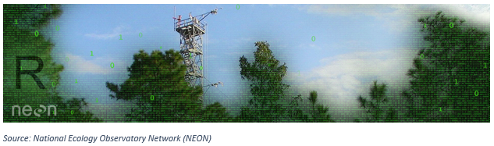
Data Cleaning Methods
Initial Project Challenges:
Obtaining location information from NEON
Combining data frames
Filtering data based on certain criteria
Methods for addressing challenges:
lapply
merge
filter

Slide 5
The lapply function
The lapply() function in R applies a function of your choosing to a list or vector and returns a list of results.
List of unique Plot IDs:
[ 493] CPER_024.mosquitPoing.mos DSNY_015.mosquitoPoint.mos
Using lapply and the get_NEON_location function:
Latlon <- lapply(uniquePlotIDs, get_NEON-location, output = ‘latlon’)
Result:
namedLocation decimalLatitude decimalLongitude
1 JORN_039.mosquitoPoint.mos 32.60528 -106.8188
Notes:
Change code to be more readable and larger like in slide 6

Slide 6
Merging Data Frames
The merge function allows the user to join together two data frames horizontally by key variables
Code Example: merge(x = Data Frame 1, y = Data Frame 2, by = “Var B”)
Data Frame 1
Data Frame 2
Result
Row # | Var A | Var B
1 | NA | 77
2 | Blue | 121
Row # | Var B | Var C
1 | 49 | Red
2 | 77 | Red
merge()
Row # | Var B | Var C | Var A
1 | 77 | Red | NA

Slide 7
Using the filter function
The filter function is used to select only certain rows of a data frame based on user specified criteria.
Code Example: dplyr::filter(Starting Data Frame$scientificName==“Culex tarsalis”)
Starting Data Frame
Result
scientificName | Count
Aedes albopictus | 82
Culex tarsalis | 103
Aedes aegypti | 8
Culex tarsalis | 64
dplyr::filter()
scientificName | Count
Culex tarsalis | 103
Culex tarsalis | 64

Slide 8
Omitted and Missing Data
Omitted Data:
Years 2012, 2013, and 2015 have been omitted
Any observations with missing plot identifications have been omitted
Observations where species or subspecies was indeterminate were omitted
Missing Data:
4530 observations in our data do not have location information
A large number of observations are missing from temperature and precipitation data
Notes:
4530/ 41080
-

Slide 9
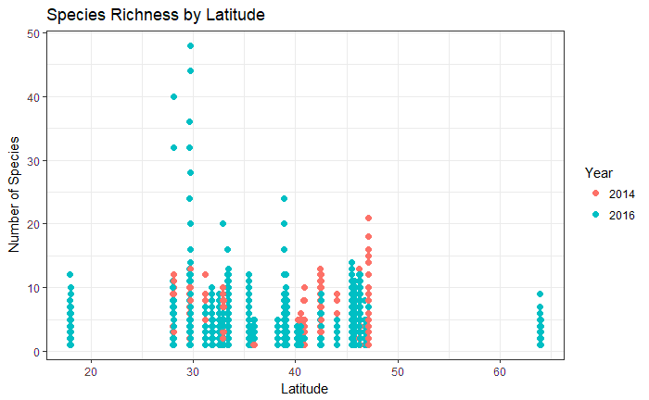
Vignette 1: Species Richness
Notes:
Clustering around 28 to 48 degrees lat. Expected because most sampling occurs on continental u.s
More data points for year 2016 than 2014
No clear pattern or relationship between species richness and latitude, casts doubt on whether an LDG exists for mosquitoes

Slide 10
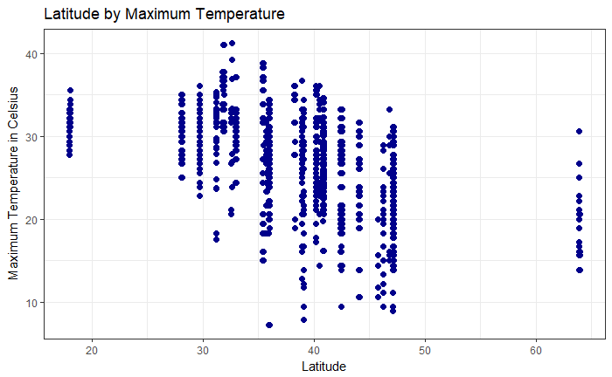
Vignette 1: Species Richness
Latitude is a proxy for environmental factors such as temperature
Notes:
Point size bigger and text larger, remove precipitation

Slide 11
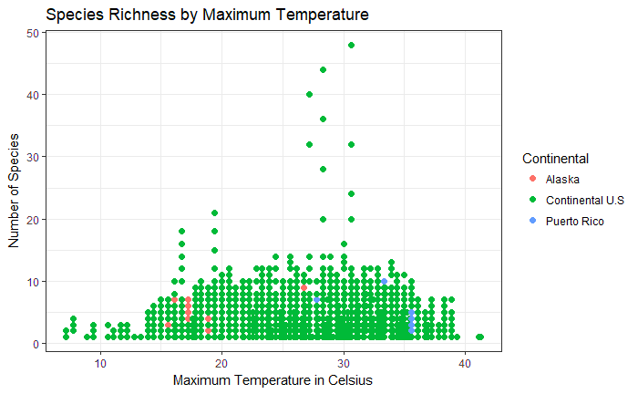
Vignette 1: Species Richness
Notes:
Change color range to reflect continental vs. alska and Puerto rico

Slide 12
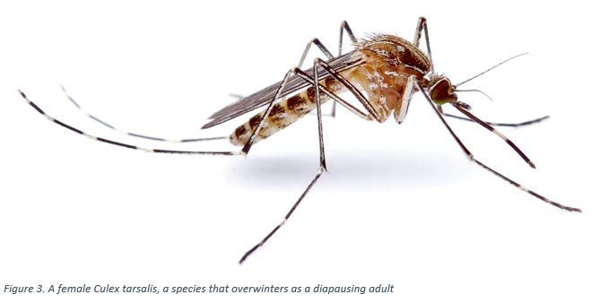
Vignette 2: Culex tarsalis
Notes:
Here is another picture of a female Culex tarsalis. For this vignette we will be taking a closer look at Cu. Tarsalis phenology and range

Slide 13
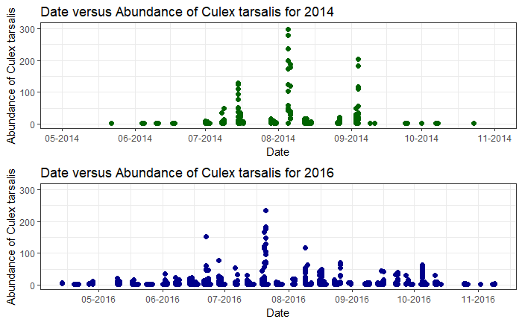
Vignette 2: Culex tarsalis
Notes:
Spikes for both years around august but appears to be a slight offset between both years
Sampling Cu. Tars a full month earlier in 2016 than in 2014 which could be something worth investigating

Slide 14
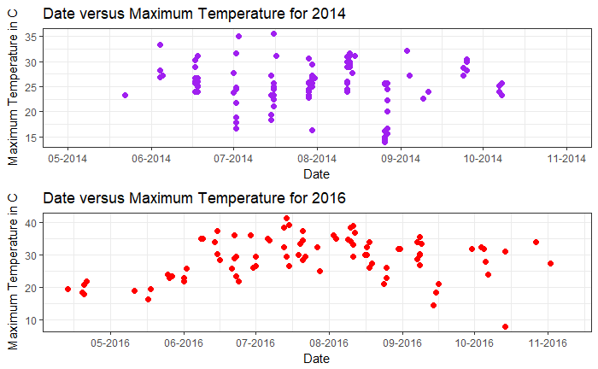
Vignette 2: Culex tarsalis
Notes:
Notice how the patterns in max temp over date appear to be relatively similar to the patterns of abundance over date
Suggests that these variables may be related

Slide 15
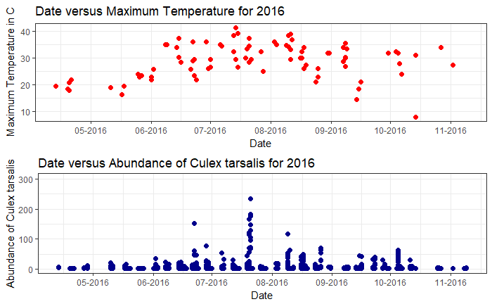
Vignette 2: Culex tarsalis
Notes:
- And in fact if we plot temperature and species richness over date, the two peaks for both graphs appear to be relatively well correlated further cementing our suspicions that culex tarsalis abundance, temperature, and date could all be related.

Slide 16
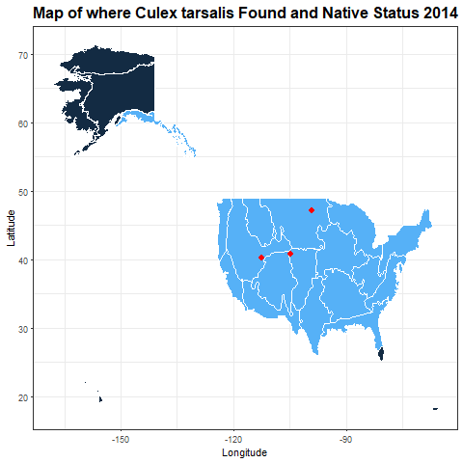
Vignette 2: Culex tarsalis
Native Status:
Native
Absent
Notes:
- Look at Culex tarsalis sampling on more of a macro scale we can see the range of this species change over time. So in 2014 we only found Cu. Tarsalis in three domains, but in 2016 we found Cu. Tarsalis in five more domains includiong D19 in Alaska. This is important because the light blue on the map indicates where Cu. Tarsalis is considered to be native and the dark blue is where this species is supposed to be absent. However sampling in 2016 found what could be the first known instance of Cu. Tarsalis appearing in Alaska, suggesting that the range of this insect is getting larger.

Slide 17
Conclusions
NEON data has captured interesting ecological phenomena that could have the potential to drive future research
This data tutorial provides only a very initial look at both species richness and Julian date of observation for Culex tarsalis
Notes:
For example the association between temperature and species richness could be of interest to ecologists who study climate change, or the appearance of Cu. Tarsalis in Alaska could be of interest to epidemiologists, all of which connect back to the core reasons why studying mosquitoes is important.
However this data tutorial provides only a very initial look at both species richness and Julian date of observation for Culex tarsalis. There’s still more work to be done, but hopefully this data tutorial will eventually give researchers the preliminary tools they need to answer some of these tough but important questions relating to mosquitoes and allow them to engage with NEON data.

Slide 18
Acknowledgements
Special thanks to Katie LeVan, Cody Flagg, and Megan Jones for providing mentorship, resources, and coding expertise.

Slide 19
Any Questions?

Slide 20
Bibliography
Hoekman, D., Y. P. Springer, C. M. Barker, R. Barrera, M. S. Blackmore, W. E. Bradshaw, D. H. Foley, H. S. Ginsberg, M. H. Hayden, C. M. Holzapfel, S. A. Juliano, L. D. Kramer, S. L. LaDeau, T. P. Livdahl, C. G. Moore, R. S. Nasci, W. K. Reisen, and H. M. Savage. 2016. Design for mosquito abundance, diversity, and phenology sampling within the National Ecological Observatory Network. Ecosphere 7:1–13.
Jetz, W., and C. Rahbek. 2001. Geometric constraints explain much of the species richness pattern in African birds. Proceedings of the National Academy of Sciences 98:5661–5666.
Mora, C., D. R. Robertson, Camilo Mora, and D. Ross Robertson. 2005. Causes of Latitudinal Gradients in Species Richness : a Test With Fishes of the Tropical Eastern Pacific. America 86:1771–1782.
Rochlin, I., D. V. Ninivaggi, M. L. Hutchinson, and A. Farajollahi. 2013. Climate Change and Range Expansion of the Asian Tiger Mosquito (Aedes albopictus) in Northeastern USA: Implications for Public Health Practitioners. PLoS ONE 8:1–9.

Slide 21
Image Sources
Bryant, P. J. 2007. Western Encephalitis Mosquito. Natural History of Orange County, California and Nearby Places. University of California, Irvine.
Gathany, J. 2002. Asian tiger mosquito, Aedes albopicts, beginning its blood-meal. Center for Disease Control and Prevention's Public Health Image Library. Center for Disease Control and Prevention.
Bertone, M. 2015. A female Culex tarsalis, a species that overwinters as a diapausing adult. NCSU PDIC Blog. North Carolina State University Plant Disease and Insect Clinic.

